Slide 1
Optical Flow from Motion Blurred Color Images
Yasmina Schoueri, Milena Scaccia, and Ioannis Rekleitis
School of Computer Science, McGill University

Slide 2
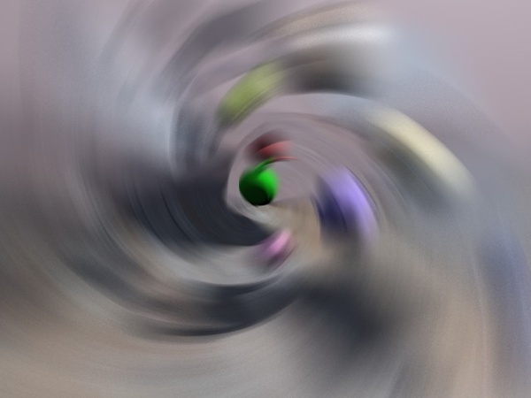
Blur
Movements cause blur in resulting image
Blur regarded as undesirable noise
Notes:
Blur contains information about the motion occurring in the scene. More specifically, the direction and the magnitude.
This information can help with image restoration in the form of deblurring as well as in determining egomotion
Examples:
- Speed of vehicles at traffic lights
- Deblurring to get license plate number

Slide 3
Related Work
I. Rekleitis. Motion estimation based on motion blur interpretation. Master’s thesis, McGill University, School of Computer Science, 1995.
W. Chen and N. Nandhakuman. Image motion estimation from motion smear - a new computational model. IEEE Transactions on Pattern Analysis and Machine Intelligence, 18(4):412–425, April 1996.
Y. Yitzhaky and N. S. Kopeika. Identification of blur parameters from motion blurred images. Graphical Models and Image Processing, 1997.
Notes:
1st: Rekleitis computed the optical flow from a single grayscale motion blurred image
2nd: Chen et al. presented a computational model that attempts to emulate the behavior of the human visual system in order to use it in machine vision systems
3rd: Yitzhaky and Kopeika developed a method for characterizing the point spread function of the blur. Their identification method bases itself on the concept that image characteristics along the direction of motion are different from characteristics in other directions

Slide 4
Motion Blur
Same as applying a linear filter
Notes:
-In most algorithms, optical flow determined from a sequence of images
-B is the blurred image, I is the image, h is the convolution kernel, alpha is the angle of the motion that caused the blur, d=VT is the number of scene points that affect a specific pixel
-Similar to multiplying the fourier transform of the image with that of the convolution kernel

Slide 5
Ripple Effect
Notes:
-Motion appears as a ripple in the frequency domain perpendicular to the direction of the motion

Slide 6
Algorithm
Image separated in respective three color channels (R, G, B)
Optical flow estimated for each then combined
Blurred Image
Vertical blur red channel
Horizontal blur green channel
Optical Flow

Slide 7
Algorithm cont’d
Notes:
1st: image patch
2nd: Power spectrum
3rd: Filter responses from 0 to 180 degrees
4th: Resulting cepstrum

Slide 8
Windowing
Avoid ringing effect
Mask image patch with 2D Gaussian
Increase frequency resolution in Fourier transform
Pixel value minus patch mean
Zero-pad patch from size N to size 2N
Notes:
When zero padding, there is an abrupt change from the pixel value to zero which makes blur harder to detect.. Instead zero pad difference between pixel value and patch mean

Slide 9
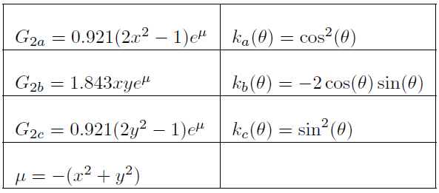
Orientation
Central ripple perpendicular to motion
Second derivative of 2D Gaussian applied
Set of steerable filters
Notes:
Set of steerable filters is applied to the power spectrum of the image patch from 0 to 180 degrees.
Orientation corresponds to degree resulting in maximal response of the filters minus 90 (since perpendicular)

Slide 10
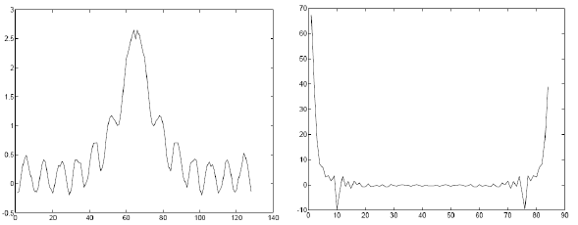
Cepstral Analysis
Collapse 2D power spectra into 1D
Lowest peak represents the magnitude
Notes:
One line of blurred image equivalent to convolution of original image with step function (which in our case is similar to a sinc function)
Period of the function equals to length of the step function which equals velocity magnitude
Period equal to lowest peak in fourier transform of sinc function
Project power spectra onto the line across the velocity vector orientation that passes through the origin

Slide 11
Combination
Orientation and magnitude for each channel
Insignificant motions not considered
Orientation difference above 45 degrees
Estimates above threshold and similar
Weighted equally
Notes:
Orientation and magnitude of motion determined for each pixel in each color channel
Pixels with steerable filter response having a difference between the maximal and minimal value less than 250 considered insignificant
If two motions have vary different orientations (angle between them above 45 degrees) they are considered to be too different and are not combined
Those that are considered significant and being similar in orientation are weighted equally and combined

Slide 12
Color vs. grayscale
Notes:
red channel blurred vertically, green channel blurred horizontally
In color application, motion determined accurately.
In grayscale, no motion detected

Slide 13
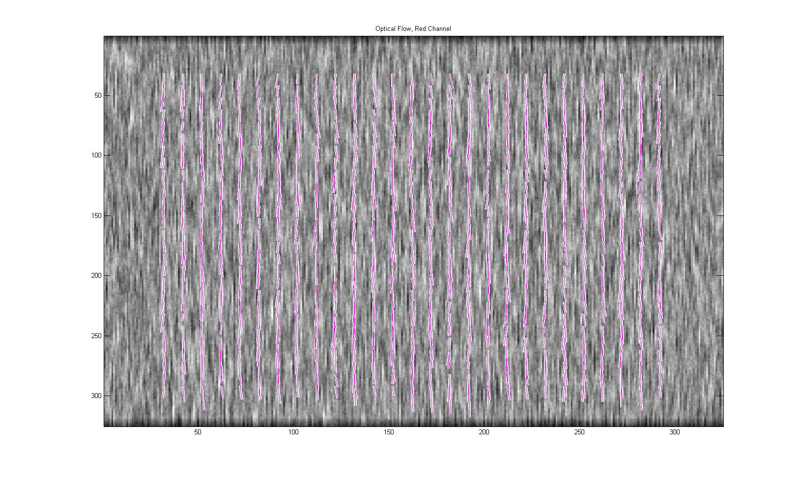
Experiments - Artificial
Notes:
Experiments were done on synthetically and naturally blurred images
Resulting optical flow in red channel

Slide 14
Experiments - Artificial
Notes:
Resulting optical in green channel

Slide 15
Experiments - Artificial
Notes:
Combined optical flow

Slide 16
Experiments – Natural-R
Notes:
Resulting optical in red channel

Slide 17
Experiments - Natural-G
Notes:
Resulting optical in green channel

Slide 18
Experiments - Natural-B
Notes:
Resulting optical in blue channel

Slide 19
Experiments - Natural
Notes:
Combined optical flow

Slide 20
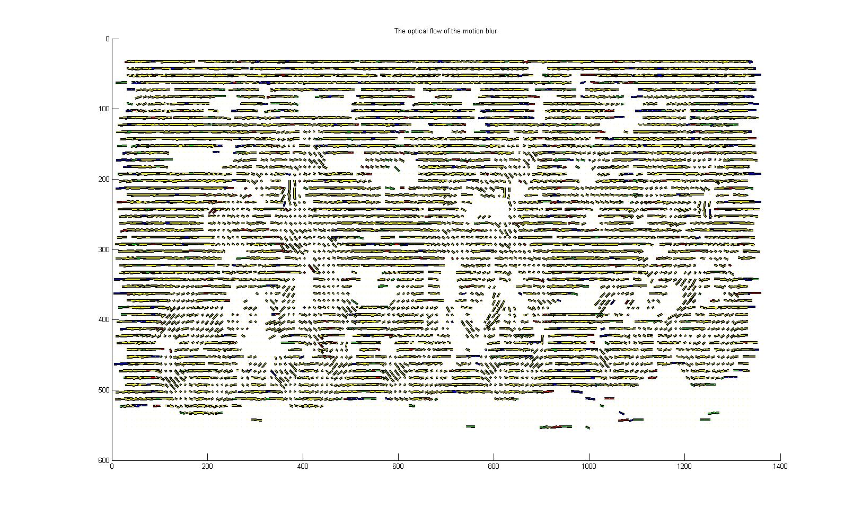
Experiments - Natural

Slide 21
London Eye - R

Slide 22
London Eye - G

Slide 23
London Eye - B

Slide 24
London Eye

Slide 25
London Eye

Slide 26
Train - R

Slide 27
Train - G

Slide 28
Train - B

Slide 29
Train

Slide 30
Train

Slide 31
Whirlwind - R

Slide 32
Whirlwind - G

Slide 33
Whirlwind - B

Slide 34
Whirlwind

Slide 35
Whirlwind

Slide 36
Future – Fields of Experts (FoE)
Learn Fields of Experts filters
Apply filters to smooth flow
FoE – method to model prior probability
Modeled as high-order Markov random field (MRF)
All parameters learnt from training data
FoE applications:
Image denoising
Image inpainting
Notes:
FoE provides a practical method for modeling prior probability of an image as a high-order Markov random field (MRF) with potential functions that extend over large pixel neighborhoods.
Clique potentials are modeled using the Product-of-Experts framework introduced by Hinton.
PoE is a generic method for learning high dimensional probability distributions.
Contrary to previous MRF approaches all parameters, including the linear filters themselves, are learned from training data.
Image denoising: remove excess noise from images (caused from blurs, lighting, …)
Image inpainting: remove scratches in images

Slide 37
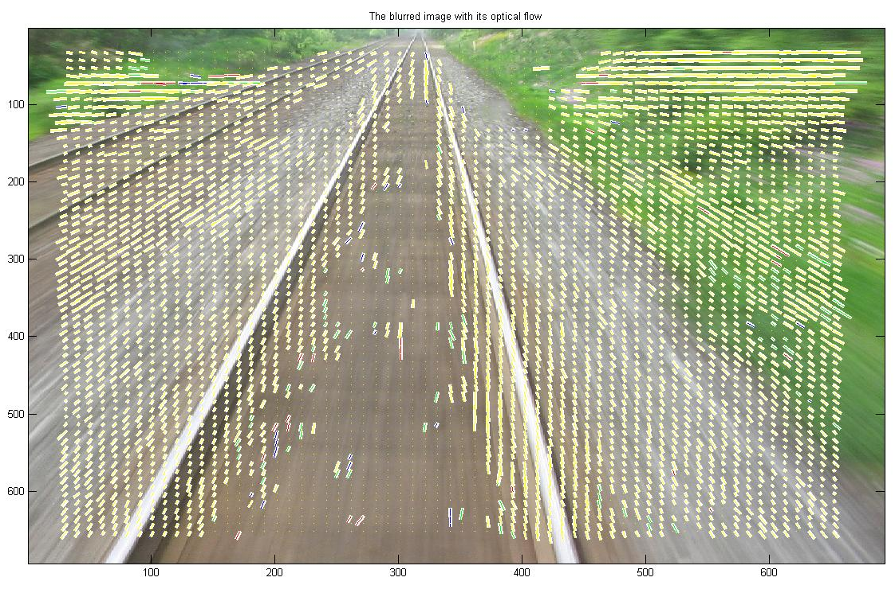
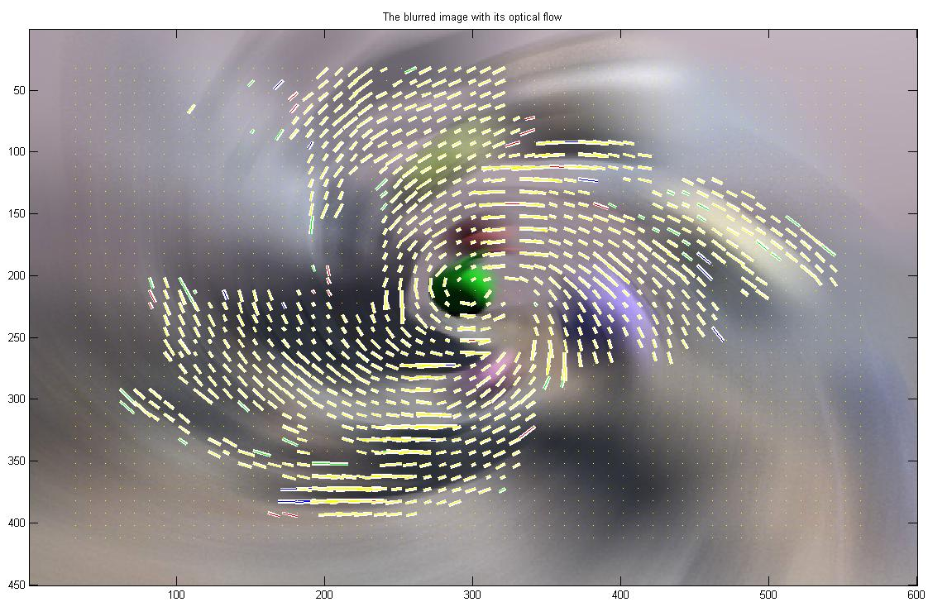
Questions?
For more information and future results:
http://www.cim.mcgill.ca/~yiannis

